Slide 1
Capstone Project
www.collaberadigital.com

Slide 2
Personal BACKGROUND
(Name, Past Experience, Qualification, Career Summary)
Name : Joey Carlo P. Francisco
Past Experience : Software Developer
Qualification : Java, HTML, CSS, JS
Career Summary : Software Developer mainly working on Java

Slide 3
What I have learned.
Key Takeaways/Learnings from the Program (HTD)
Operating dataload utility as well as configuring the 3 main config files. Dataload, environment config, business object config file
Customizing the solr documents/rows by adding new fields and defining it in search profile xml
Creating rest handlers and defining it in necessary config files then invoking command controllers
Creating new and extending existing command controllers and where to configure it.
Creating JPAs and DataBeans
Customizing widgets and modifying JSP pages
Creating new JSP and mapping it spring configuration metadata

Slide 4
Problem Statement of the Capstone Project
Part 1:
Step 1: add data into catentry table field 3,4 (hint via dataload)
Field 3: product ranking
field 4 : rating Company
Table Updated : CATENTRY
Step 2: Add these 2 fields to SOlr index and display the information on PDP page (Solr Index extension, refer to product ranking customization)
Step 3: Add one attribute for product (dataload) : is product gift wrapable
Tables to be updated : ATTR, ATTRVAL, ATTRVALDESC
Step 4: On PDP page : Add product to basket
Step 5: allow customer to add gift wrap service and add a message save in Order if Gift wrap is available and customer selects the checkbox for gift wrap
Hint (Data to be saved in ORDITEMEXTATTR)
Step 6: On Order confirmation: display if gift warp service was selected by customer and display the gift message

Slide 5
Problem Statement of the Capstone Project
Part 2:
Step 1: Complete User registration : add 2 fields User favourite colour favourite food Save in custom table, using JPA. Extend the user registration command
Step 2: Display user information in profile

Slide 6
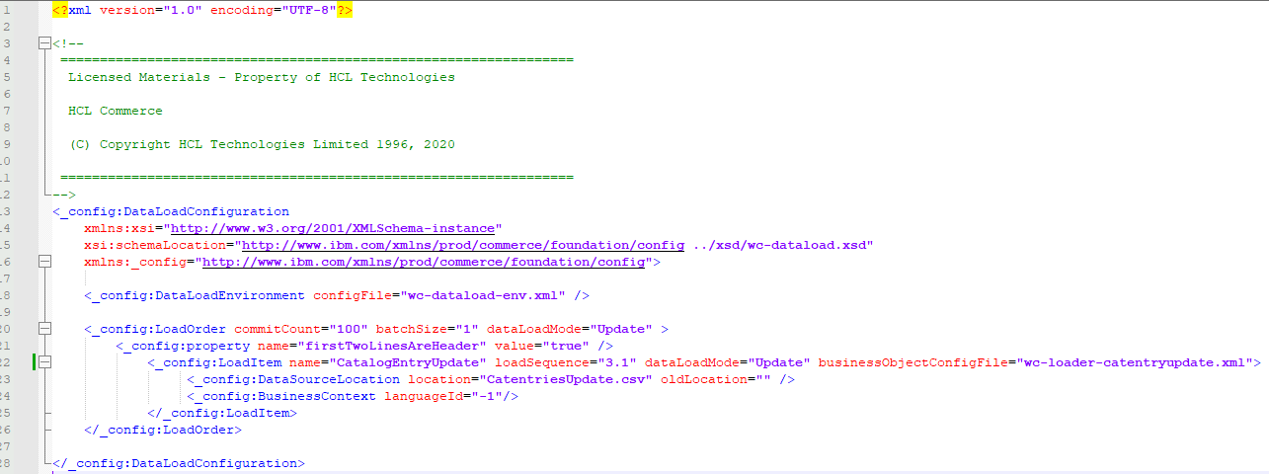
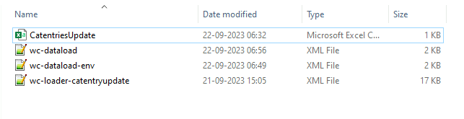
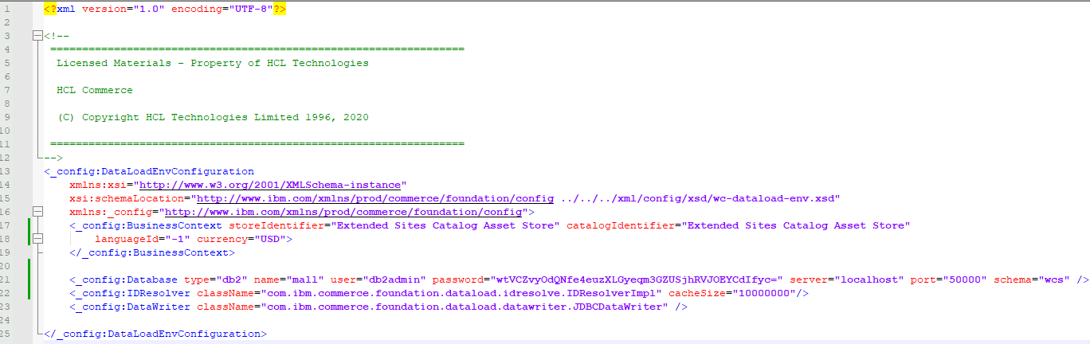
PART 1 STEP 1
DATALOADING
wc-dataload.xml
wc-dataload-env.xml

Slide 7
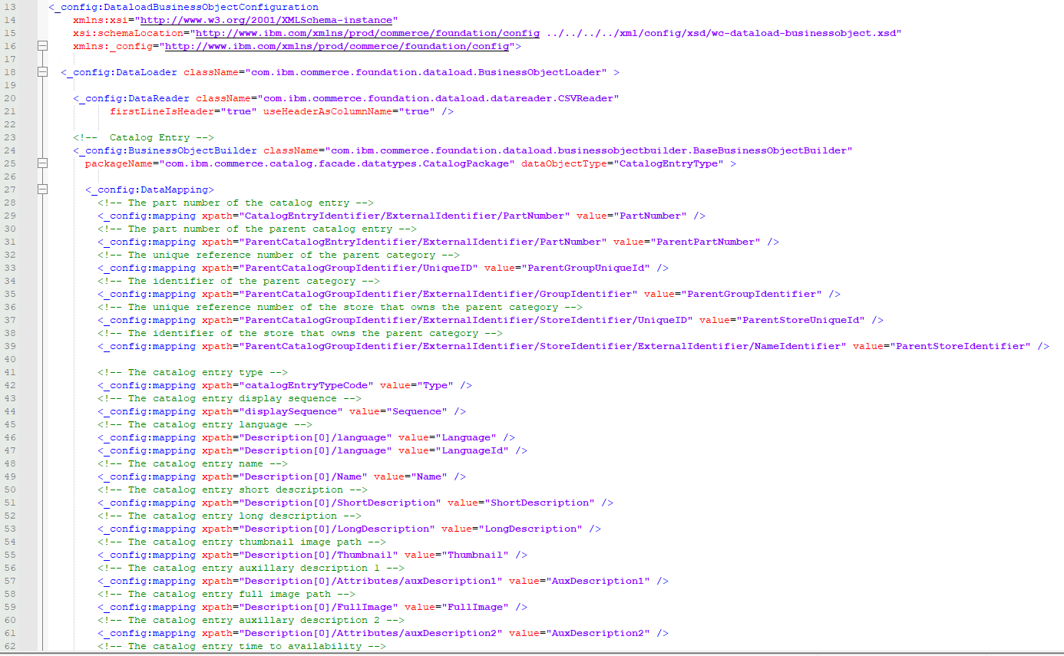
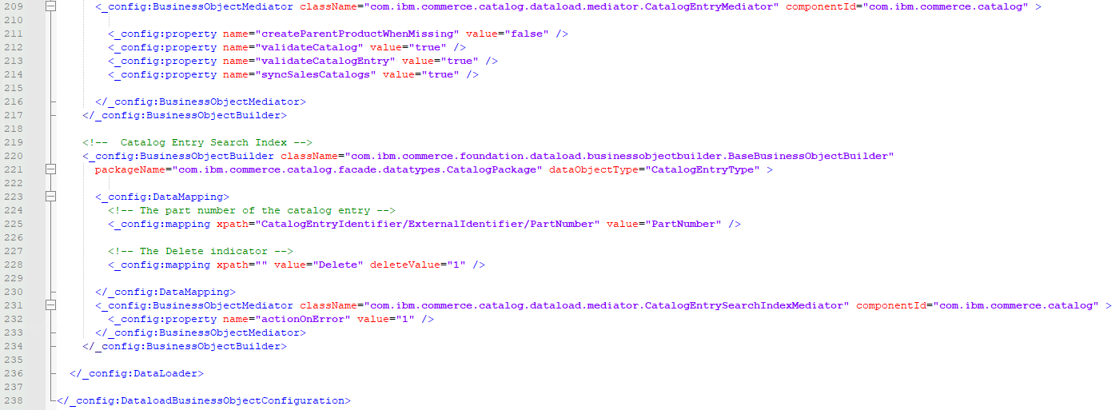
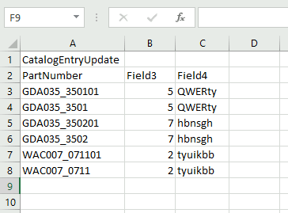
PART 1 STEP 1
wc-loader-catentryupdate.xml
CatentriesUpdate.csv

Slide 8
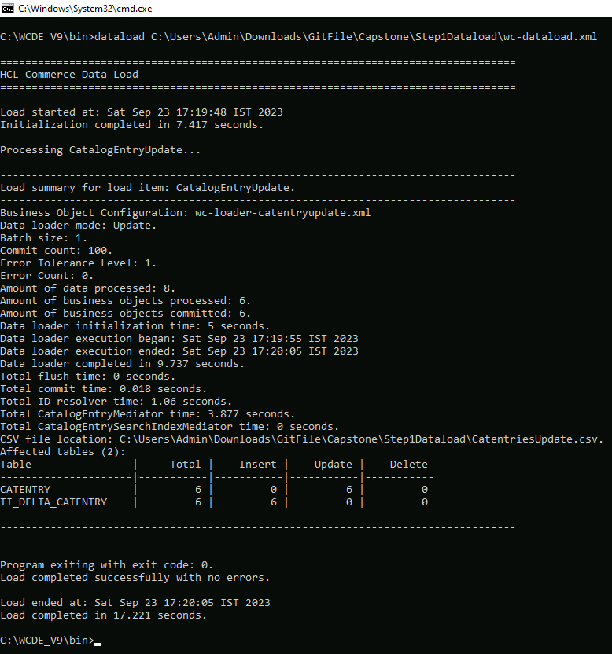
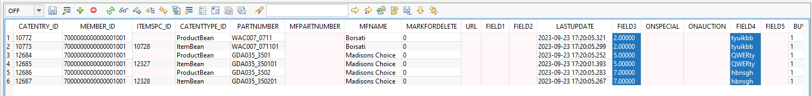
PART 1 STEP 1

Slide 9
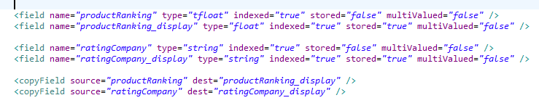
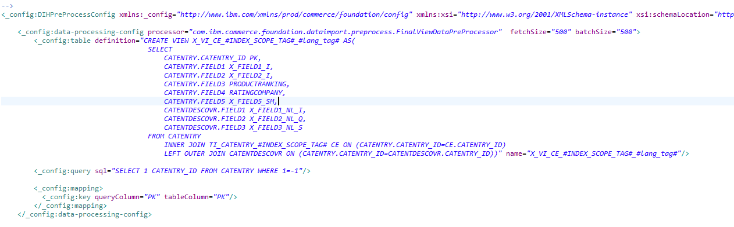
PART 1 STEP 2
/search-config-ext/src/index/managed-solr/config/v3/CatalogEntry/x-schema.xml
/WC/xml/search/dataImport/v3/db2/CatalogEntry/wc-dataimport-preprocess-x-finalbuild.xml

Slide 10
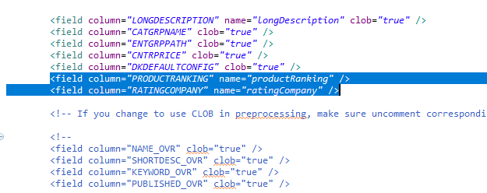
PART 1 STEP 2
/search-config-ext/src/index/managed-solr/config/v3/CatalogEntry/x-data-config.xml
Build the Index
curl --user spiuser:passw0rd --insecure -X POST https://localhost:443/wcs/resources/admin/index/dataImport/build?masterCatalogId=10001
Check the Build
curl --user spiuser:passw0rd --insecure -X GET https://localhost:443/wcs/resources/admin/index/dataImport/status?jobStatusId=1501
SOLR document check
http://localhost:3737/solr/MC_10001_CatalogEntry_en_US/select?q=catentry_id:10772

Slide 11
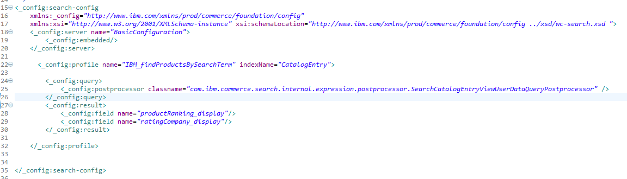
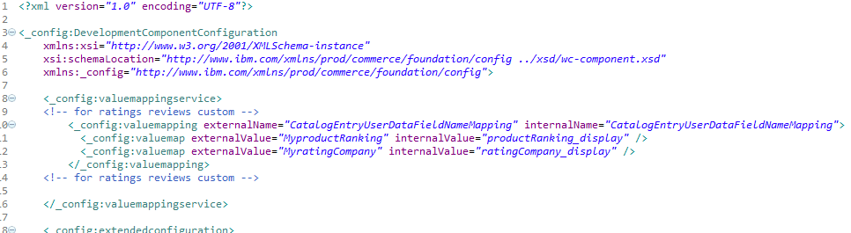
PART 1 STEP 2
/search-config-ext/src/runtime/config/com.ibm.commerce.search/wc-search.xml
/search-config-ext/src/runtime/config/com.ibm.commerce.search/wc-component.xml

Slide 12
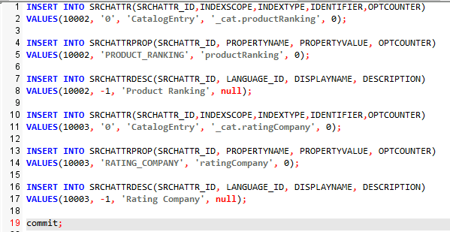
PART 1 STEP 2
Search table inserts

Slide 13
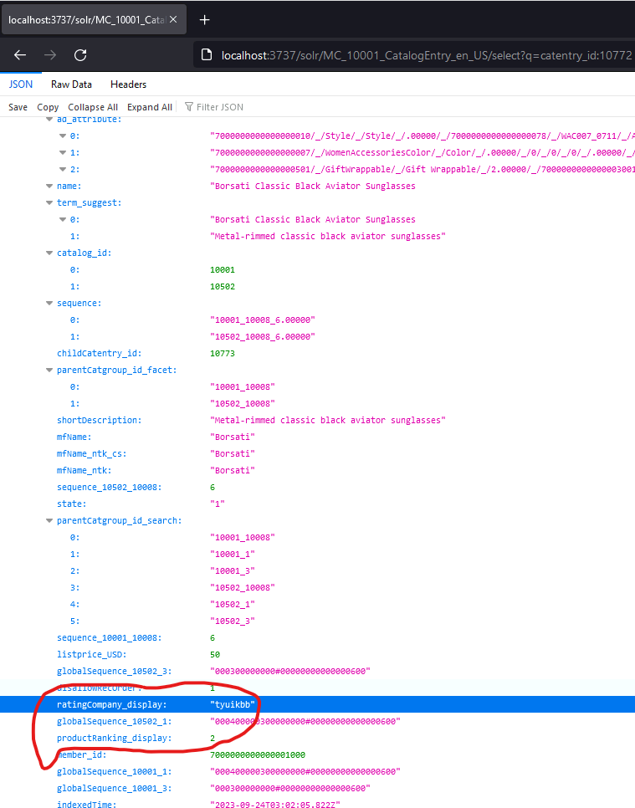
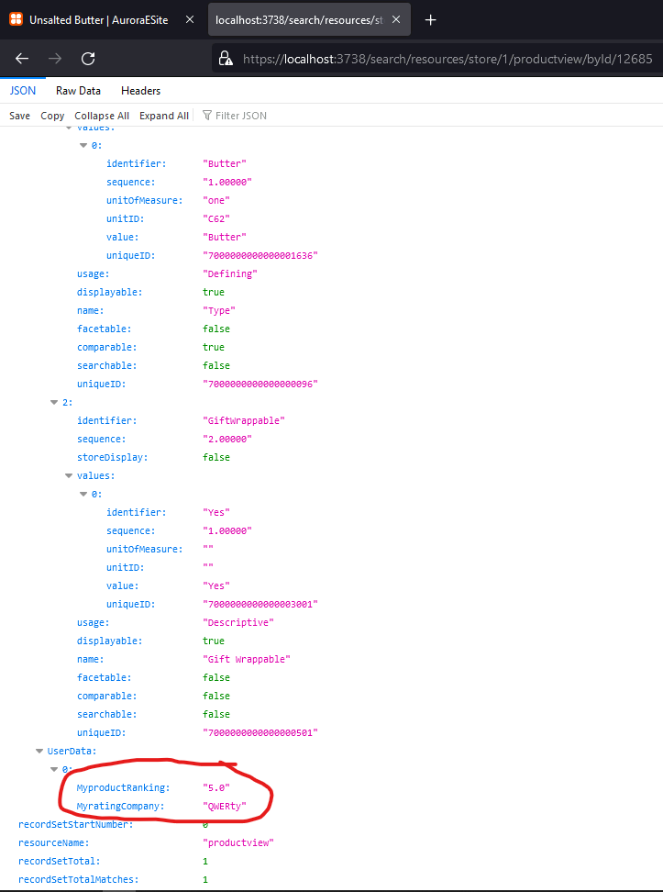
PART 1 STEP 2
Checked if fields are showing in solr search
https://localhost:3738/search/resources/store/1/productview/byId/12685
Checked in Solr document result as well
http://localhost:3737/solr/MC_10001_CatalogEntry_en_US/select?q=catentry_id:10772

Slide 14
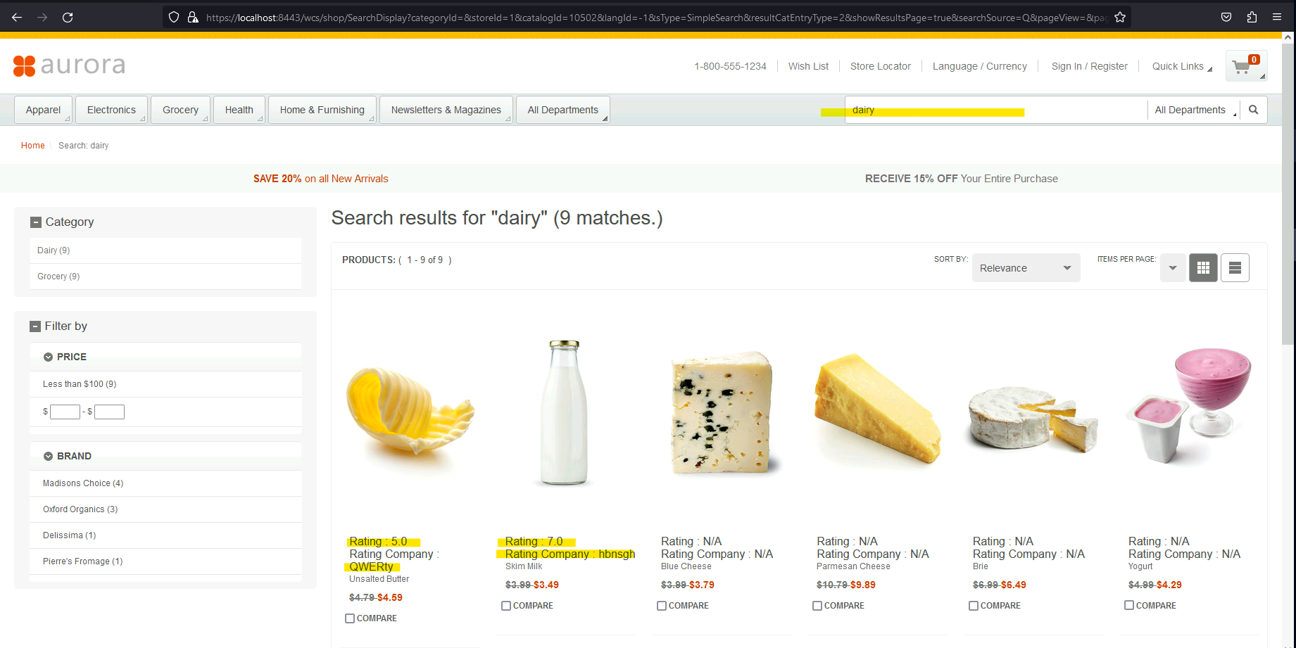
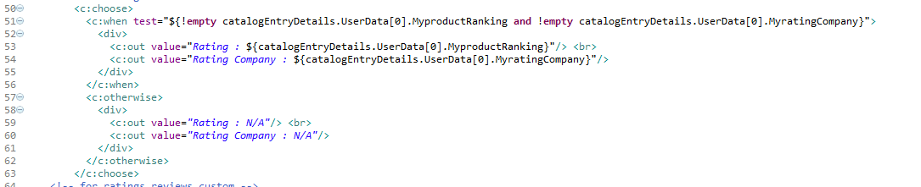
PART 1 STEP 2
DISPLAYING IT IN SEARCH LISTING PAGE
CatalogEntryDisplay_GridView_UI.jspf

Slide 15
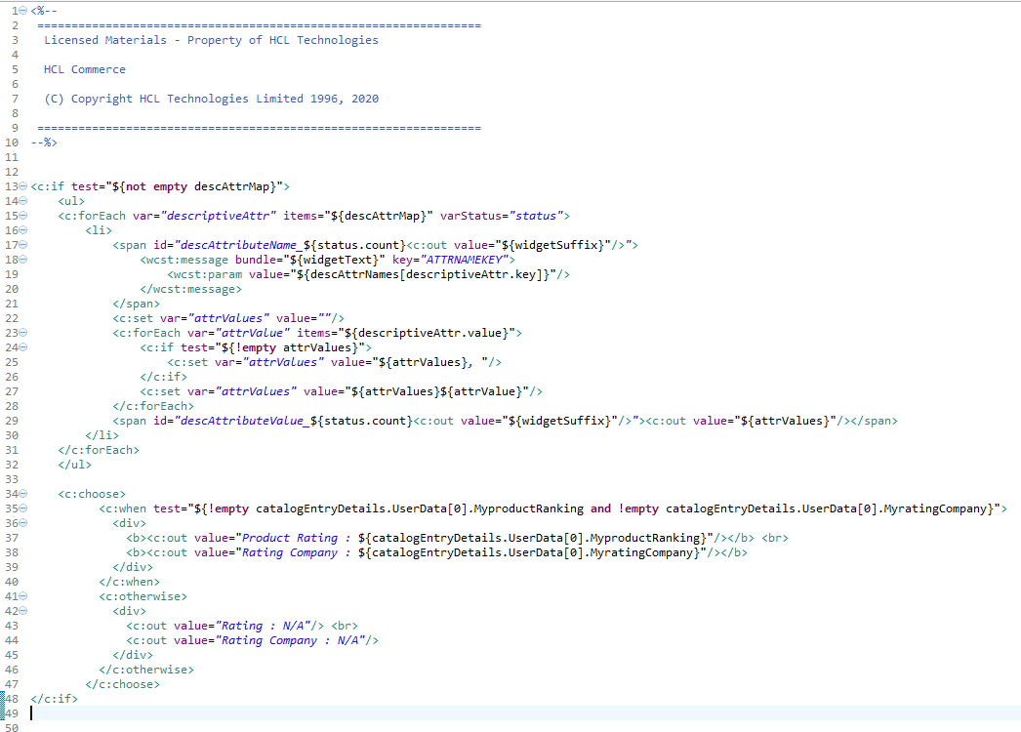
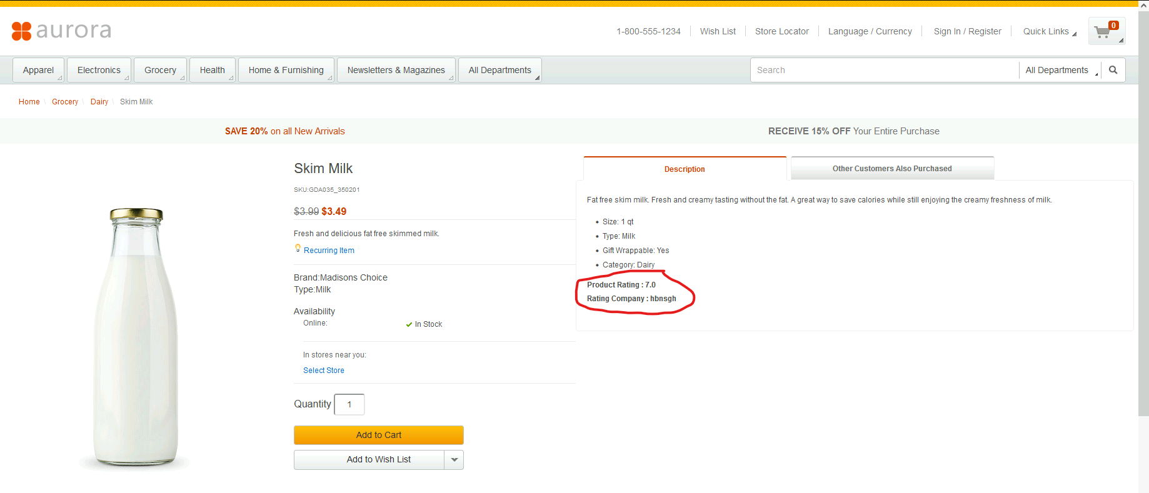
PART 1 STEP 2
DISPLAYING IT IN PRODUCT DETAIL PAGE (PDP)
DescriptiveAttributes_UI.jspf

Slide 16
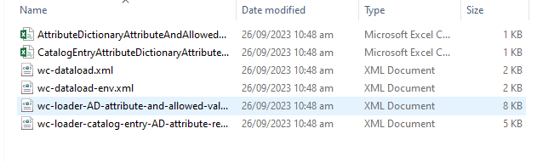
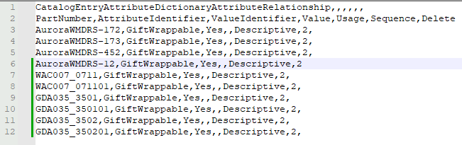
PART 1 STEP 3
DATALOADING ATTRIBUTES(DATASOURCES)
CatalogEntryAttributeDictionaryAttributeRelationship.csv
AttributeDictionaryAttributeAndAllowedValues.csv

Slide 17
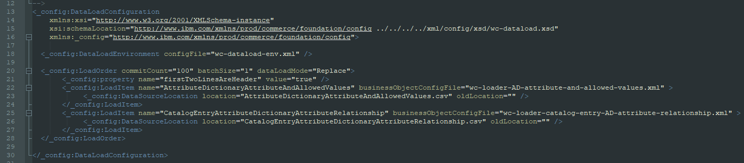
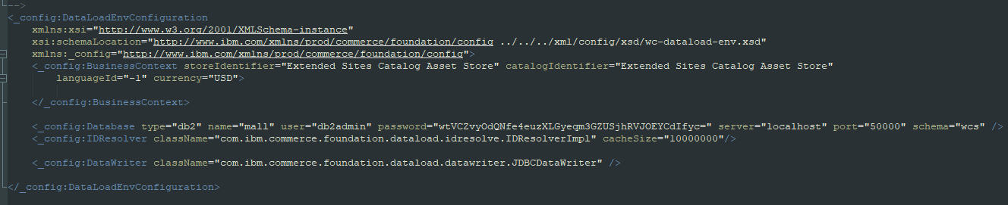
PART 1 STEP 3
Dataload config and environment config
wc-dataload.xml
wc-dataload-env.xml

Slide 18
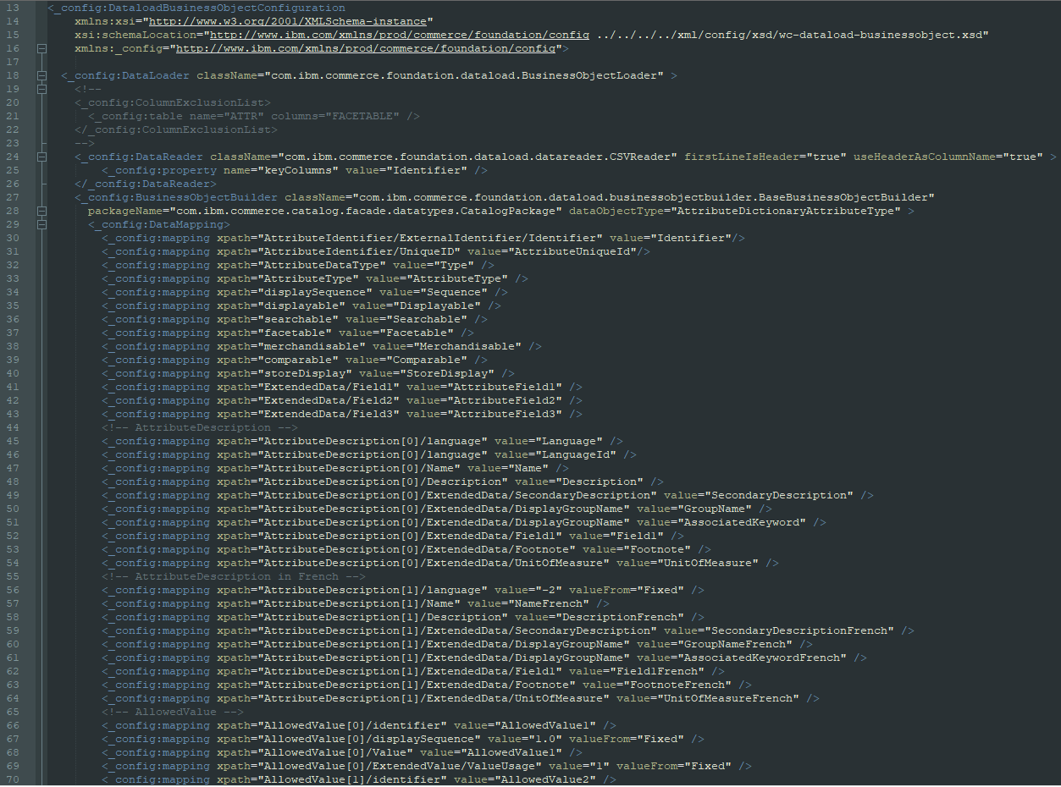
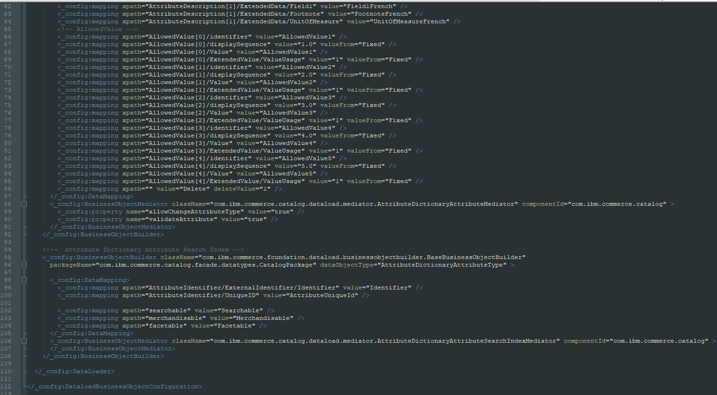
PART 1 STEP 3
wc-loader-AD-attribute-and-allowed-values.xml

Slide 19
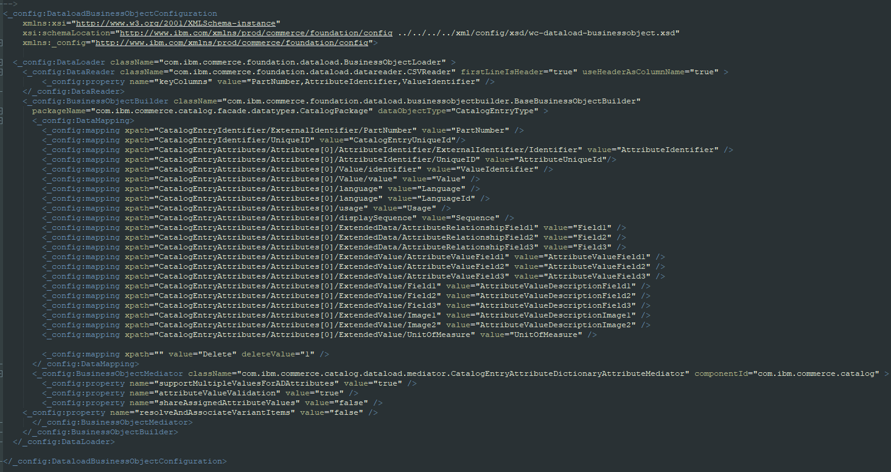
PART 1 STEP 3
wc-loader-catalog-entry-AD-attribute-relationship.xml

Slide 20
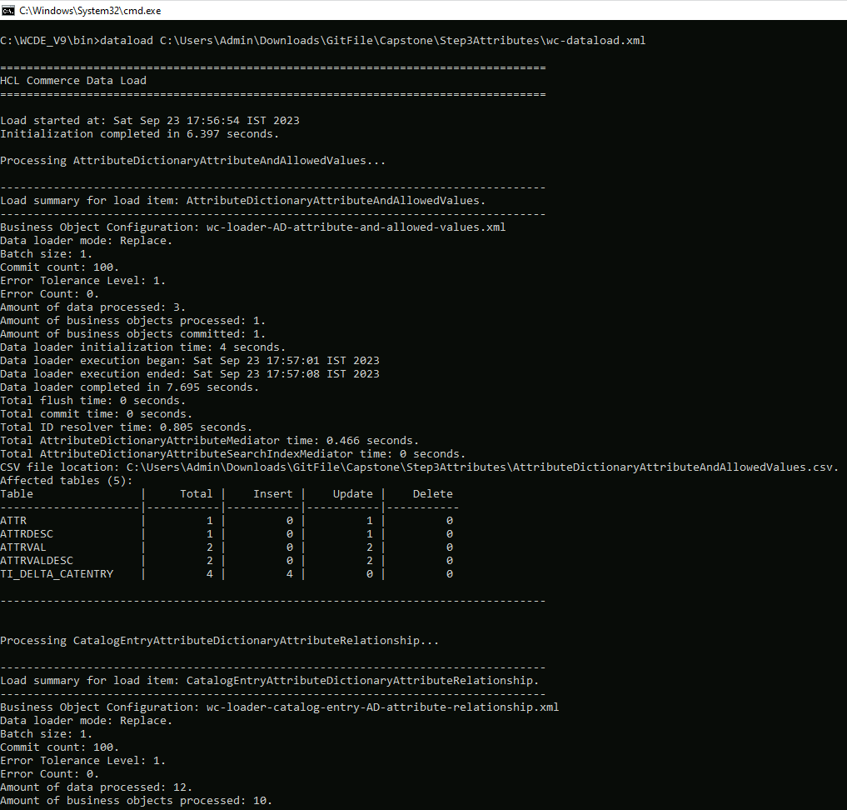
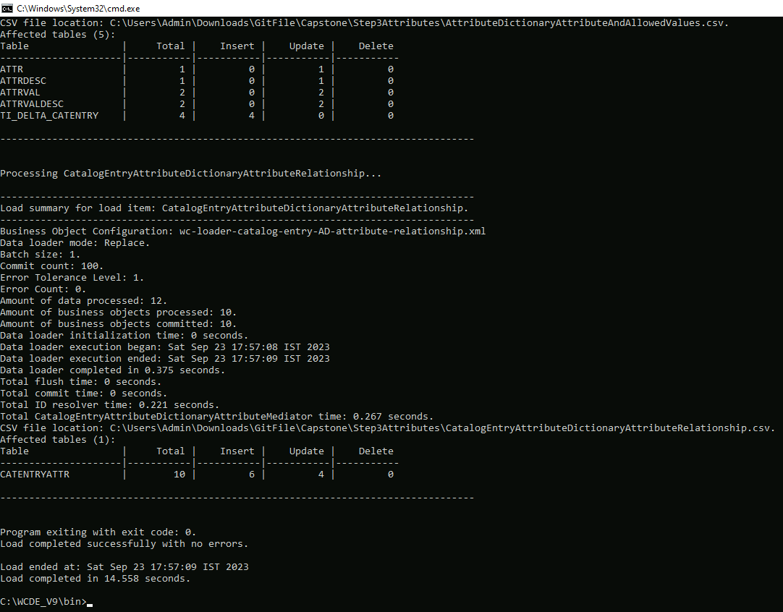
PART 1 STEP 3

Slide 21
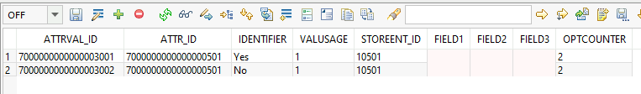
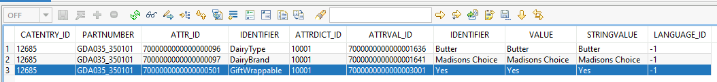
PART 1 STEP 3
ATTR
ATTRVAL
PRODUCT VERIFICATION
ATTRVALDESC
Build the Index
curl --user spiuser:passw0rd --insecure -X POST https://localhost:443/wcs/resources/admin/index/dataImport/build?masterCatalogId=10001
Check the Build
curl --user spiuser:passw0rd --insecure -X GET https://localhost:443/wcs/resources/admin/index/dataImport/status?jobStatusId=1501
SOLR document check
http://localhost:3737/solr/MC_10001_CatalogEntry_en_US/select?q=catentry_id:10772

Slide 22
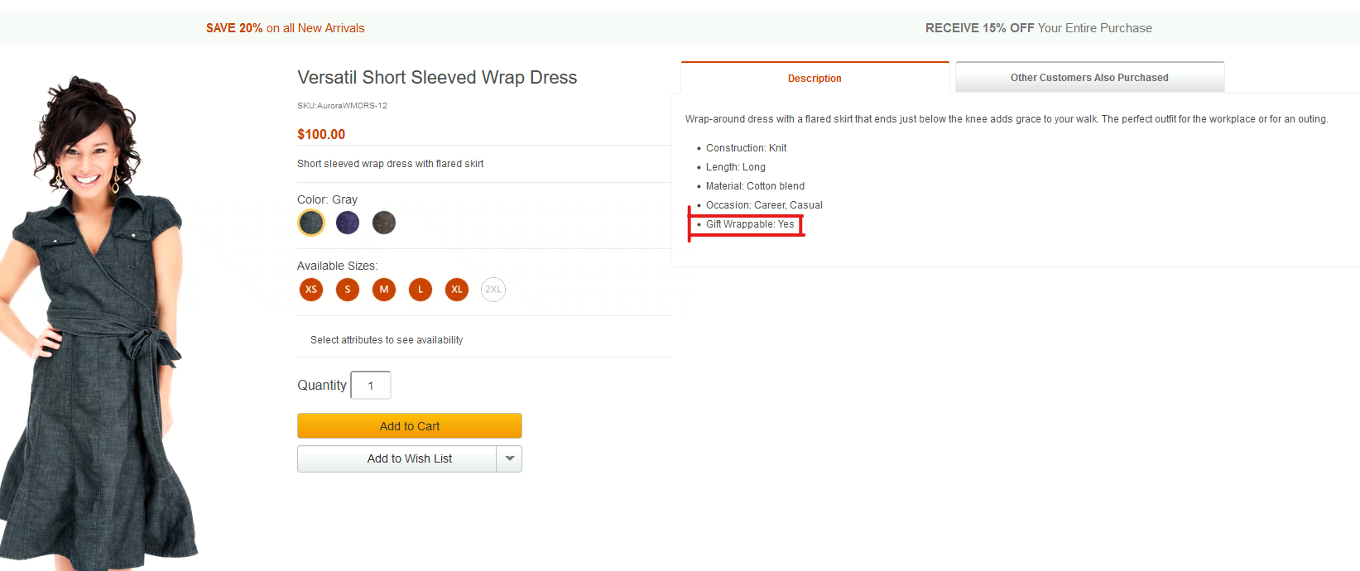
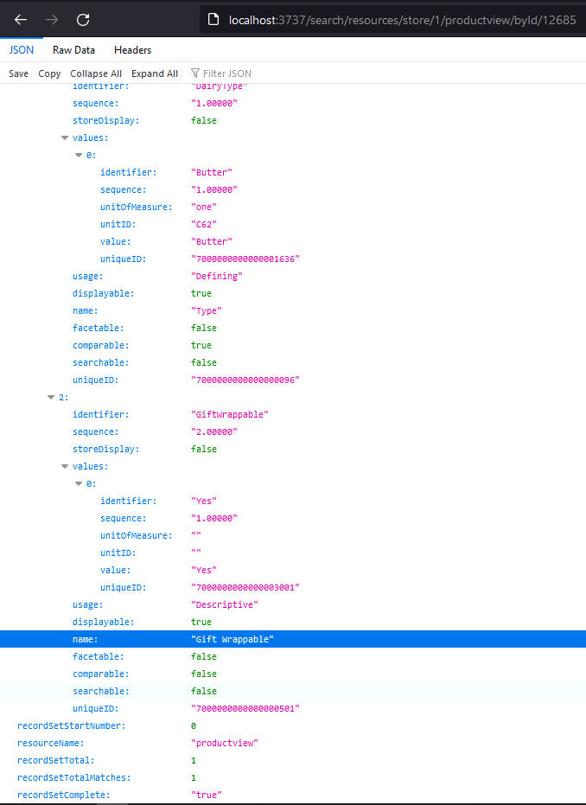
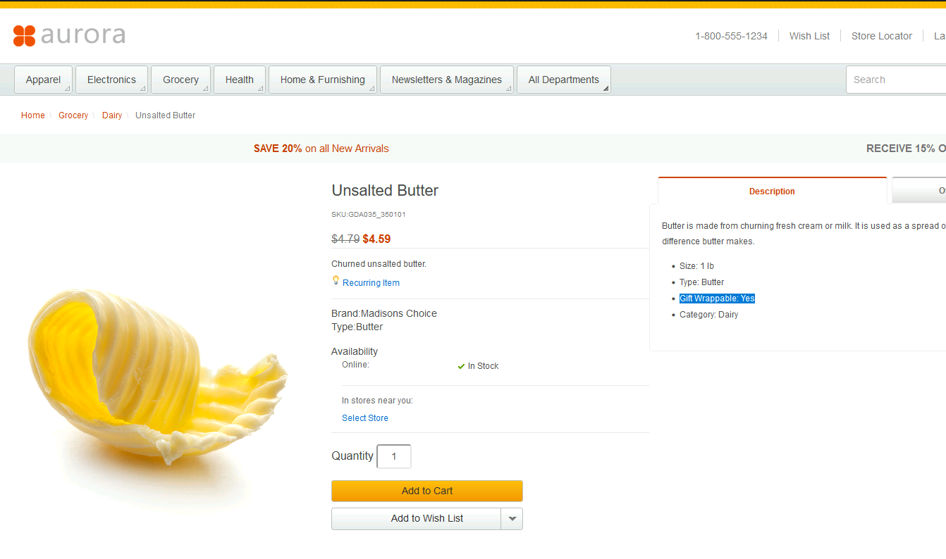
PART 1 STEP 3
STOREFRONT RESULT

Slide 23
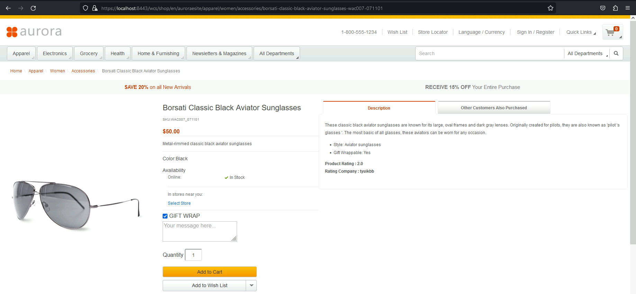
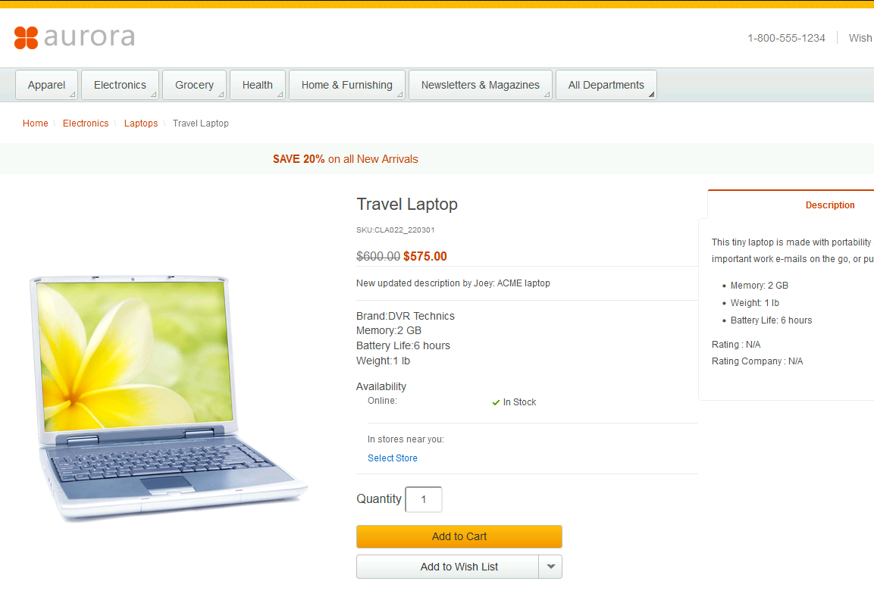
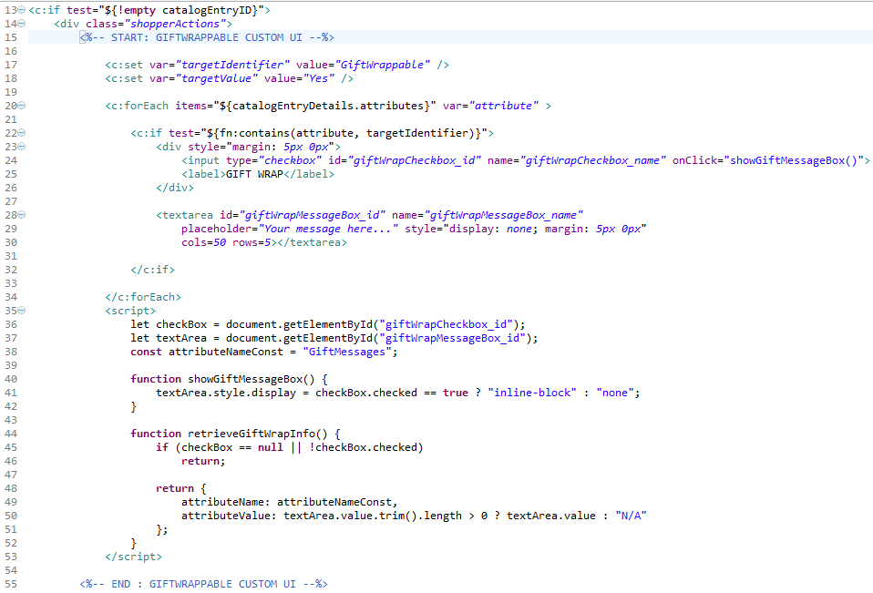
PART 1 STEP 4-6
GiftWrappable item
Non-giftwrappable item

Slide 24
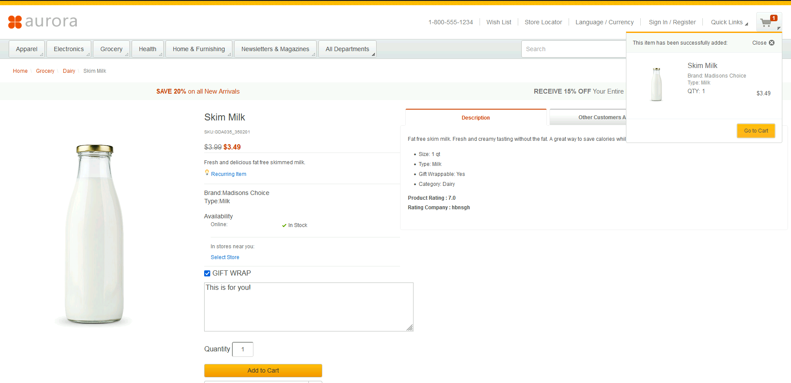
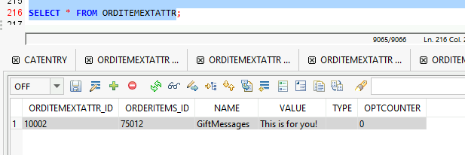
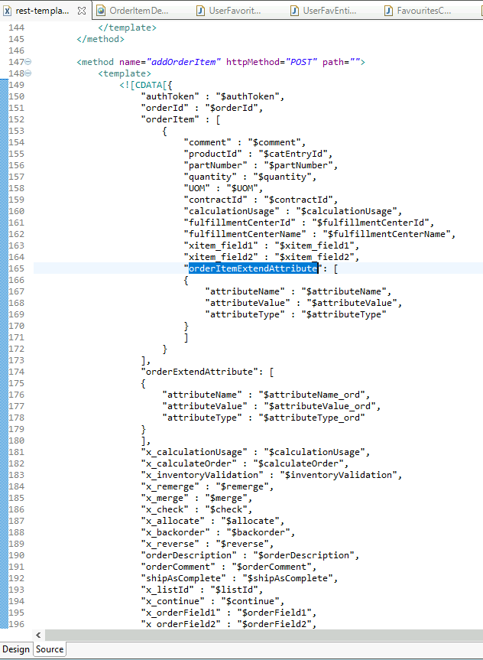
PART 1 STEP 4-6
UPON ADD TO CART
/crs-web/WebContent/WEB-INF/xml/config/com.ibm.commerce.order/rest-template-config.xml

Slide 25
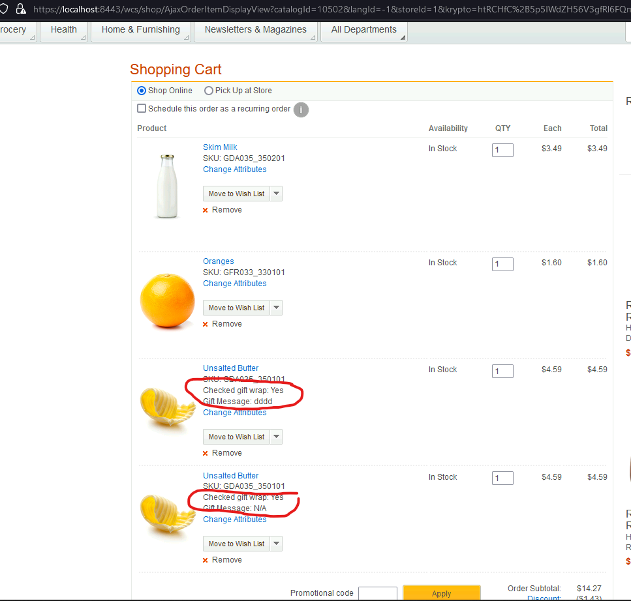
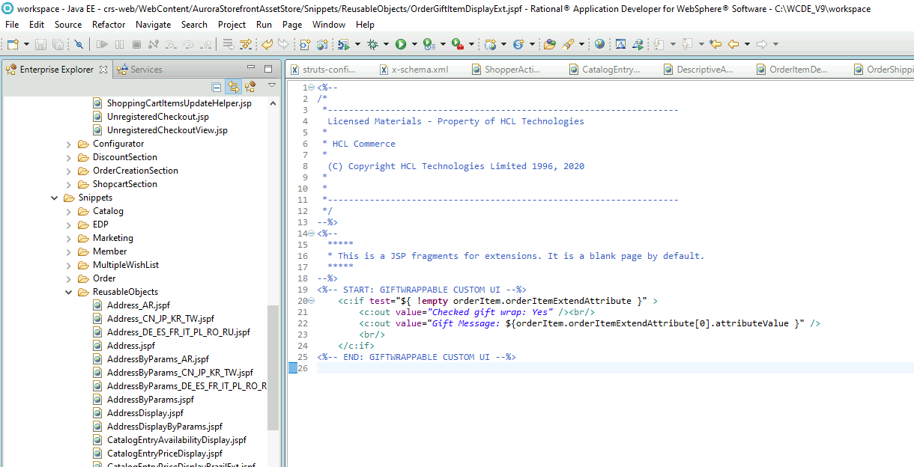
PART 1 STEP 4-6
OrderGiftItemDisplayExt

Slide 26
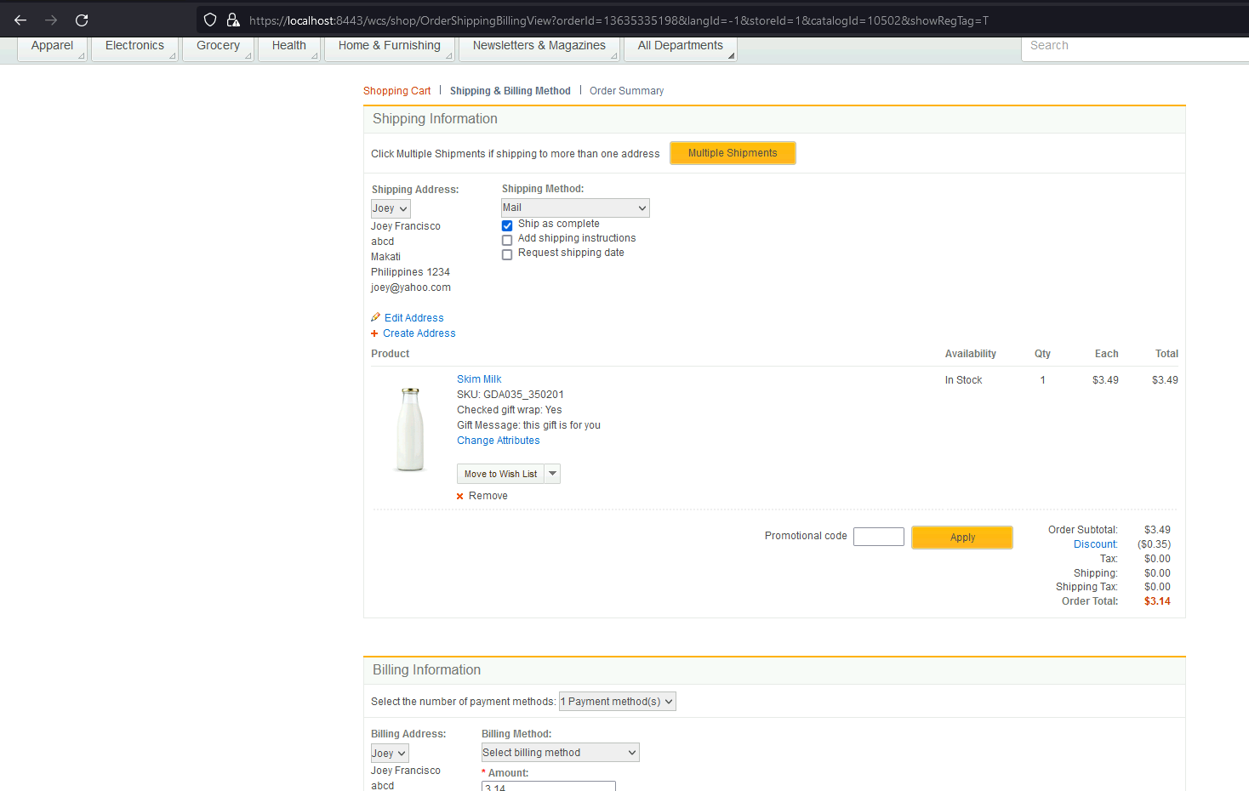
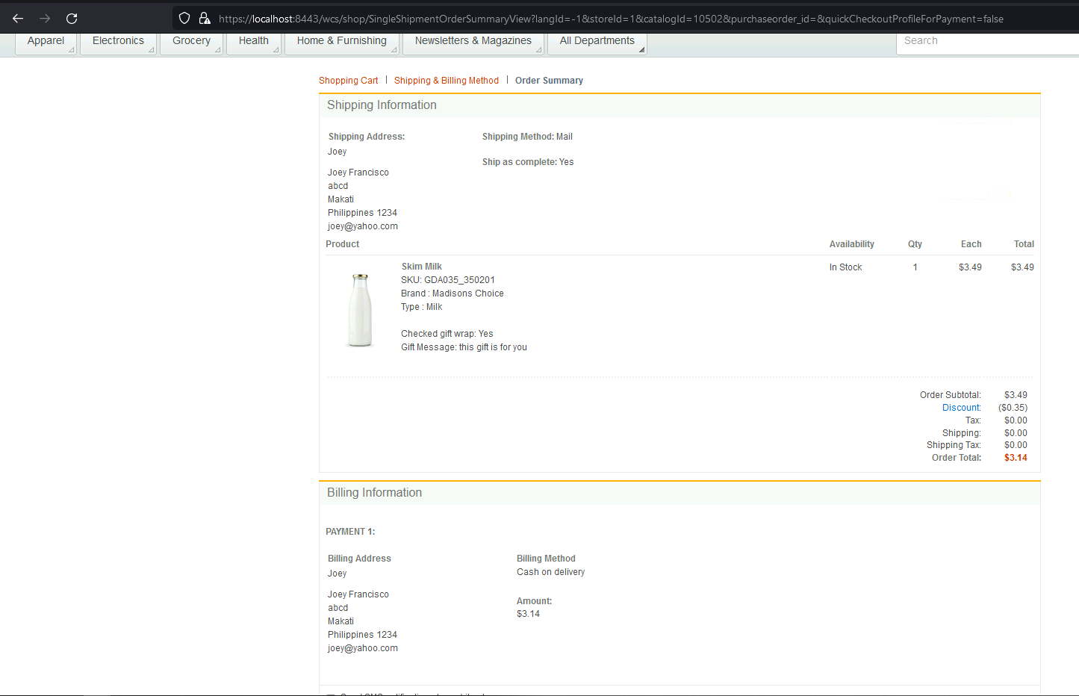
PART 1 STEP 4-6

Slide 27
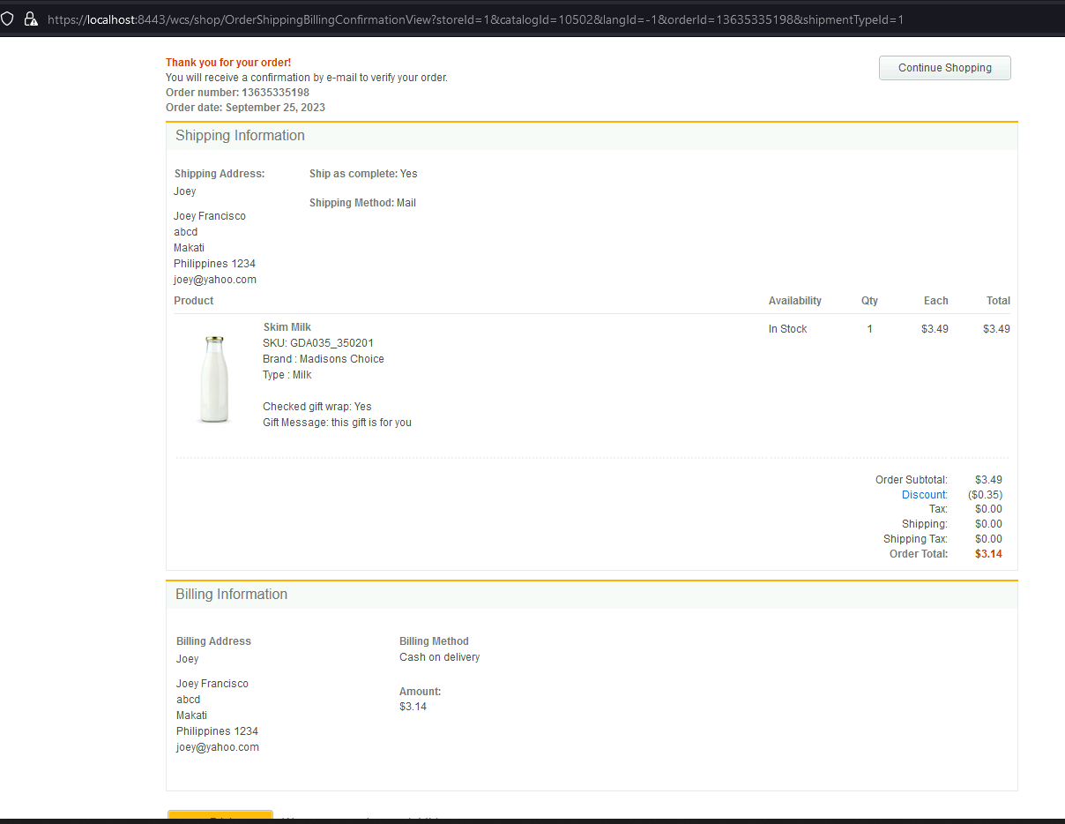
PART 1 STEP 4-6
ORDER CONFIRMATION PAGE

Slide 28
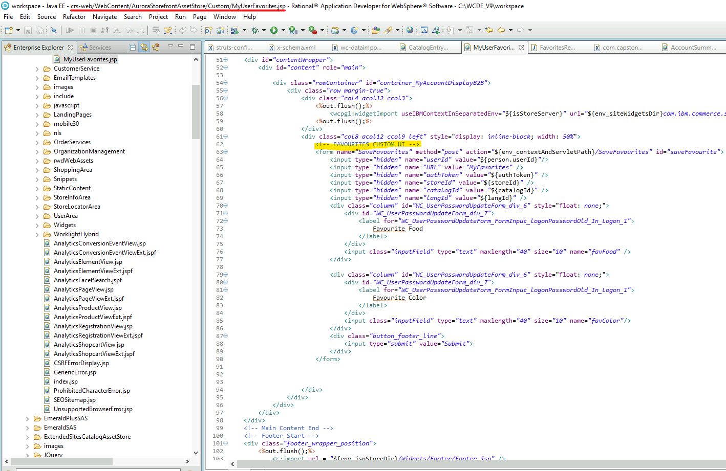
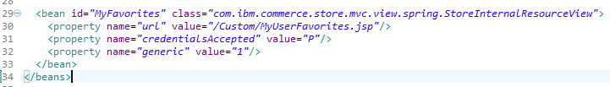
PART 2
Create custom JSP page for the UI
Then I registered it to views-ext.xml

Slide 29
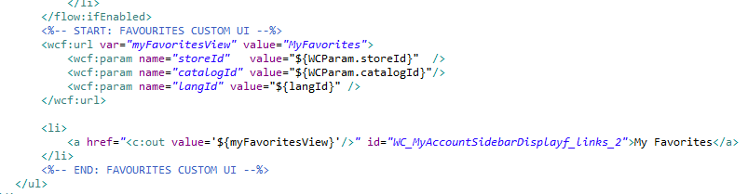
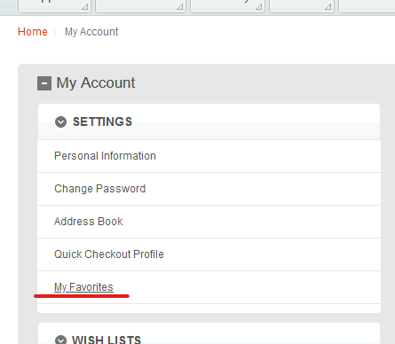
PART 2
Modified MyAccountNavigation_UI.jspf widget to add my custom link
MyAccountNavigation_UI.jspf

Slide 30
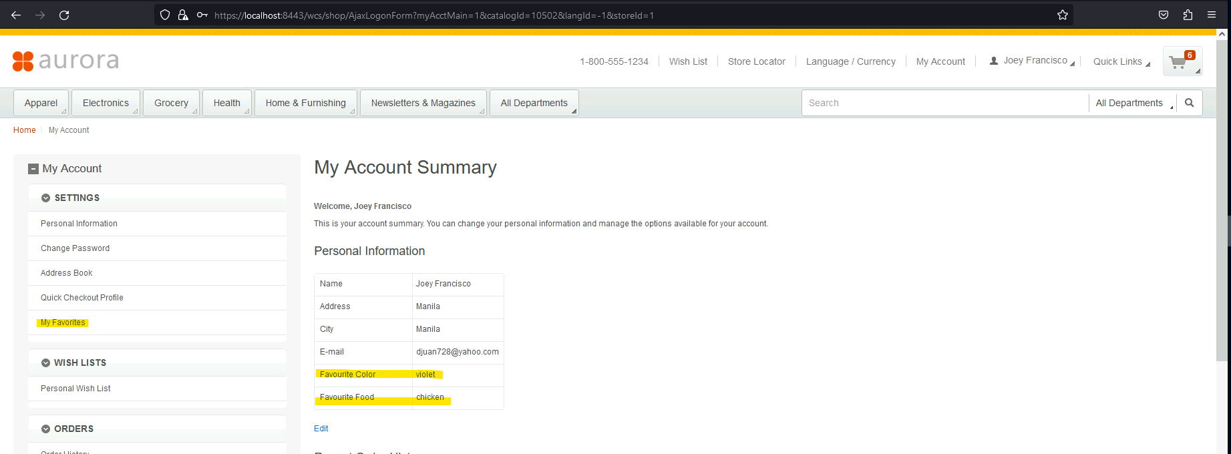
PART 2
Account summary page
The favorites from my custom table is automatically fetched via rest call upon opening of summary page

Slide 31



PART 2
My custom favorites page
If we put a values here and the user already has entry in db, favourite food and color column will only be updated
X_USERFAVORITES

Slide 32


PART 2
extensionsData and ExtensionsLogic files involved and RestHandler

Slide 33


PART 2 Register RestHandler
I registered the rest handler in resources-ext.properties
Since the rest handler is calling commandController for saving the favorites to
Db and command controller is receiving parameters in body of POST we have to
Create entry in commandMapping along with the inputs and outputs
/Rest/WebContent/WEB-INF/config/commandMapping/com.capstone.commands.FavouritesControllerCmd.xml

Slide 34


PART 2 DataAccessBean
For retrieving the data, I’ve created a dataBean. For this to receive input from request so
We also need to create a mapping in beanMapping folder similar to command
/Rest/WebContent/WEB-INF/config/beanMapping/com.capstone.databeans.RetrieveFavouritesDataBean.xml

Slide 35


PART 2 Entity Class and DAO implementation

Slide 36


PART 2 ControllerCommands

Slide 37


PART 2 TaskCommands

Slide 38



PART 2 Saving the data
Upon submission of favourite color and food, it will go through an action with method of POST which we have to define in controllers-ext.xml
rest-template-config.xml
Since we are doing post we have to create the template of our request
In rest-template-config.xml

Slide 39
END
THANK YOU

